Slide 1
Predicting Online Learning Outcomes With Clickstream
Qiwei Men
Department of Educational Studies
April 3rd, 2020

Slide 2
Overview
01
04
02
05
03
06
Introduction
Methodology
MOOCs and online learning
Exploratory factor analysis (EFA) & LDA
Literature Review
Results
Previous valuable studies in learning analytics
Distinction, Pass or Fail?
OULD dataset
Discussion & Conclusion
On University Learning Analytics dataset
What do we learn from this project

Slide 3

MOOC is Changing The Game of Education
Introduction
Massive maybe 100,000 students in a MOOC
Open anyone, anywhere, anytime
Online delivered via the internet.
Course similar with online courses

Slide 4
Problem Statement
What are the problems & weaknesses of MOOCs now?
Low Completion Rates One of the biggest problems with MOOCs is that so far the courses have had incredibly low completion rates – most are under 10%
Lack of One-on-One Teaching and Interaction In a class with 50,000 students, there is not a lot of opportunity to get face time with your professor, as you might in a traditional environment.
Difficult to track status of each student It is difficult to keep track of students’ assignments and involvement
Integrity (AKA Cheating) A lack of personal attention from the teachers and TAs can also lead to an increase in cheating amongst students.
Lack of Accreditation the quality of online courses was thought to be questionable, the diplomas and certificates obtained online are not highly recognized by the public.

Slide 5
Problem Statement
The interested problems of this project are :
Can we use learners' clickstream to trace their learning behaviors and predict their outcome (fail, pass or distinction)?
How click actions influence the learner's performance, and what inspirations can we get for optimizing the course design.
The purpose of this project is establishing an effective model for learning state tracing and performance prediction base on the clickstream made by learners.
This model can be used to:
Identify students at risk of failing and make intervention.
Identify students who may cheat with unusual click patterns and unreasonable outcomes.
Identify students with excellent performance and promote their successful experience.

Slide 6
Literature Review
“Predicting At-Risk Students Using Clickstream Data in the Virtual Learning Environment”
Naif et al. deployed a long short-term memory(LSTM ) model using Open University Learning Analytics dataset to predict the performance (pass or fail) of students with around 90% accuracy by analyzing the clickstream data generated in the first 10 weeks of student interaction in a virtual learning environment (VLE).
the advantage of this model is it captured the learning behavior of students and efficiently predicted the at-risk students on the basis of their interactions and engagement patterns.
The limitations are :
This model only used interaction data, but there are also other information may be helpful for making prediction.
This model only predict the outcome fail or pass but ignore the difference between pass and distinct students.
Naif et al.
long short-term memory(LSTM ) model (2019)

Slide 7
Literature Review
“Predicting performance on MOOC assessments using multi-regression models”
Ren, Rangwala, and Johri used the personalized multiple linear regression (PLMR) model to analyze the data from Edx and predict the scores that a student may achieve on a given grade-related assessment based on features of session, quiz, homework, video and time to capture a student’s studying behavior and learning habits. The study found that features associated with engagement (logging multiple times), studying materials (viewing videos and attempting quizzes) were important along with prior homework scores for this prediction problem.
The advantage of this study is it provides an effective method for tracking and predicting the short-term performance, which is helpful for the teaching team to learn the state of students timely.
The limitation of this research is that the model only focuses on predicting the short-term outcomes but didn’t give a further prediction for the final outcome.
Ren, Rangwala, and Johri
personalized multiple linear regression model (PLMR) (2016)

Slide 8
Literature Review
“Behavior-based grade prediction for MOOCs via time series neural networks”
Yang et al. (2017) used the method of time series neural network to analyze the lecture video-watching clickstreams and predict students’ average CFA grade in two MOOCs. They firstly only used the past quiz data to make the prediction, then move to a developed model by adding the clickstream data. The result show that the involvement of clickstream data improve the prediction accuracy significantly. The result suggests that the learning performance is a result of the combination of multiple factors.
The limitations of this study is that the model largely depend on the previous quiz performance, but plenty of students never do quiz in MOOCs, which makes the model inapplicable in some cases. Moreover, neural network is a complicated model, a sophisticated pre-processing needs to be employed before the analysis, the process and the result are also difficult for understanding and interpretation.
Yang et al.
time series neural networks (2017)

Slide 9

ABOUT THE OULD DATA SET
The OULD data set contains data from courses presented at the Open University (OU).
The dataset contains the information about 22 courses, 32,593 students, their assessment results, and logs of their interactions with the VLE represented by daily summaries of student clicks (10,655,280 entries). The dataset is freely
available at https://analyse.kmi.open.ac.uk/open_dataset under a CC-BY 4.0 license.

Slide 10
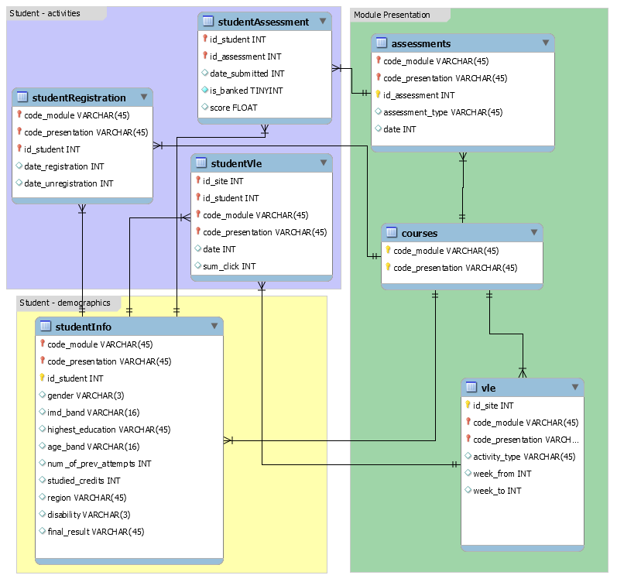
Data Preprocessing

Slide 11
1,538 entries, 8 total columns
Active days
Viewed Contents
Resource
OU Contents
How many days the student makes at least 1 click
How many contents the student has viewed
Lectures, Videos Created by OU
Other learning materials like readings and software
Forum
Quiz
CMA score
Final Result
asking questions, making discussions
Sample questions related to the content
Score of quiz, weight 5-10%
Distinction, Pass or Fail

Slide 12
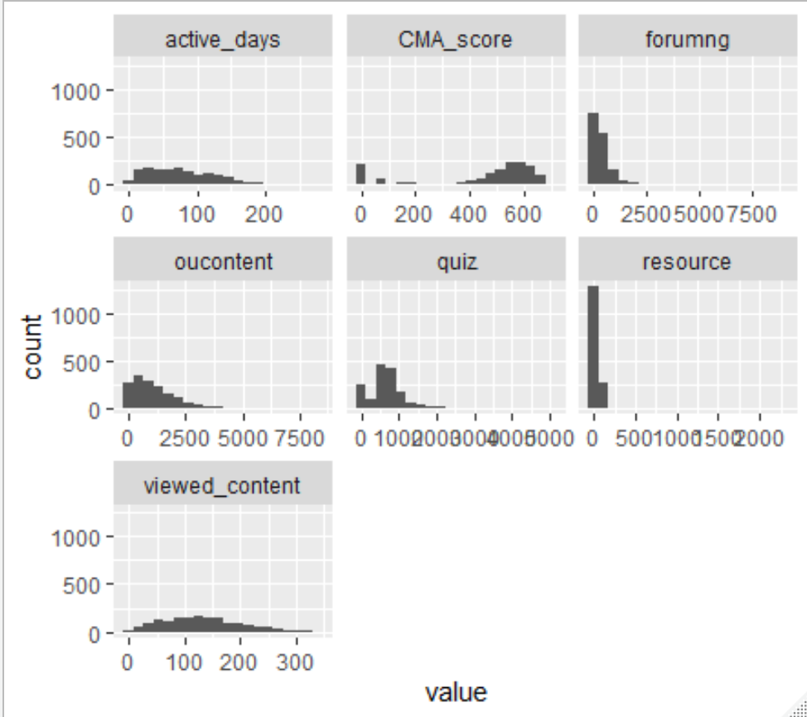
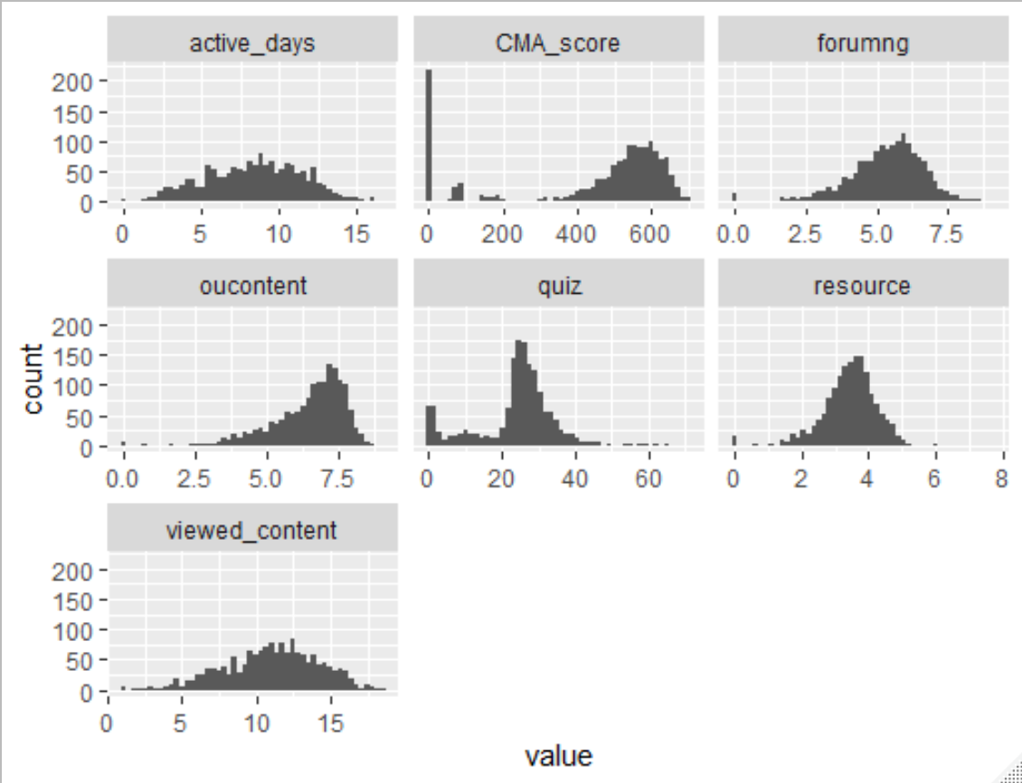
Data Transformation

Slide 13
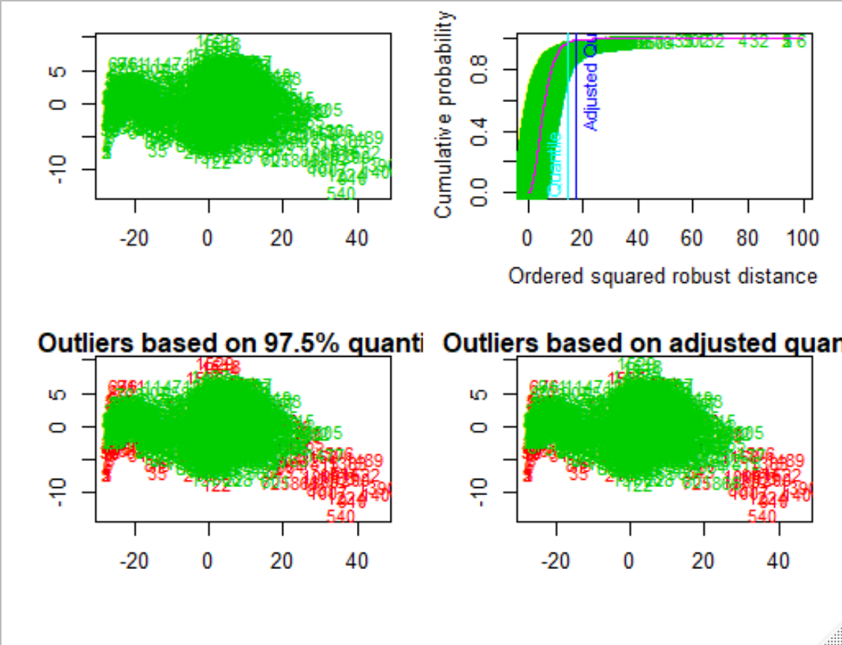
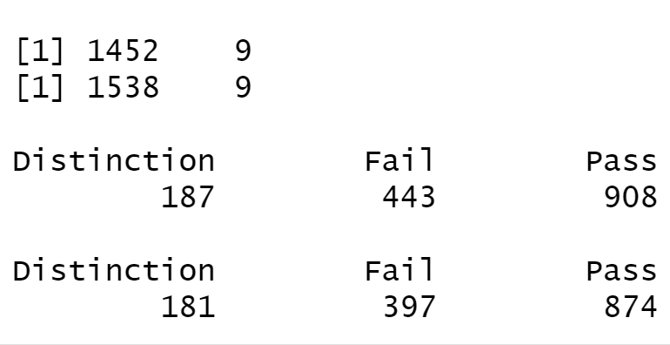
Outlier Detecting
Use movoutlier() to detect outliers
0.057 outliers were reduced

Slide 14
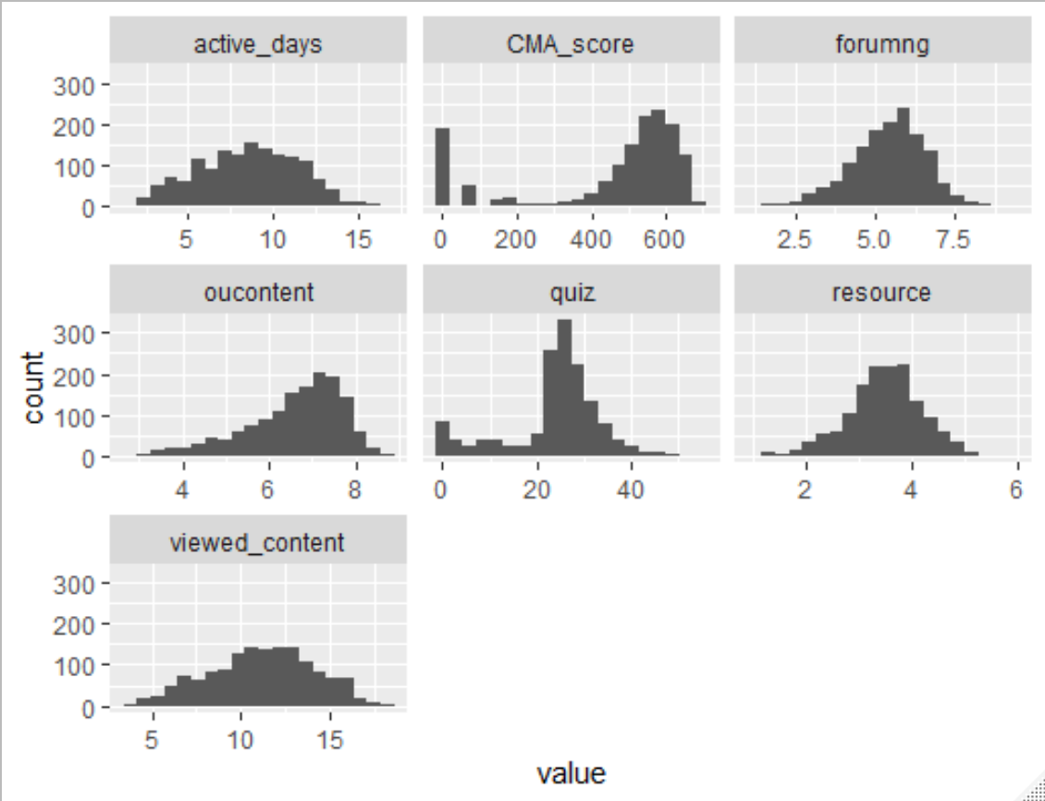
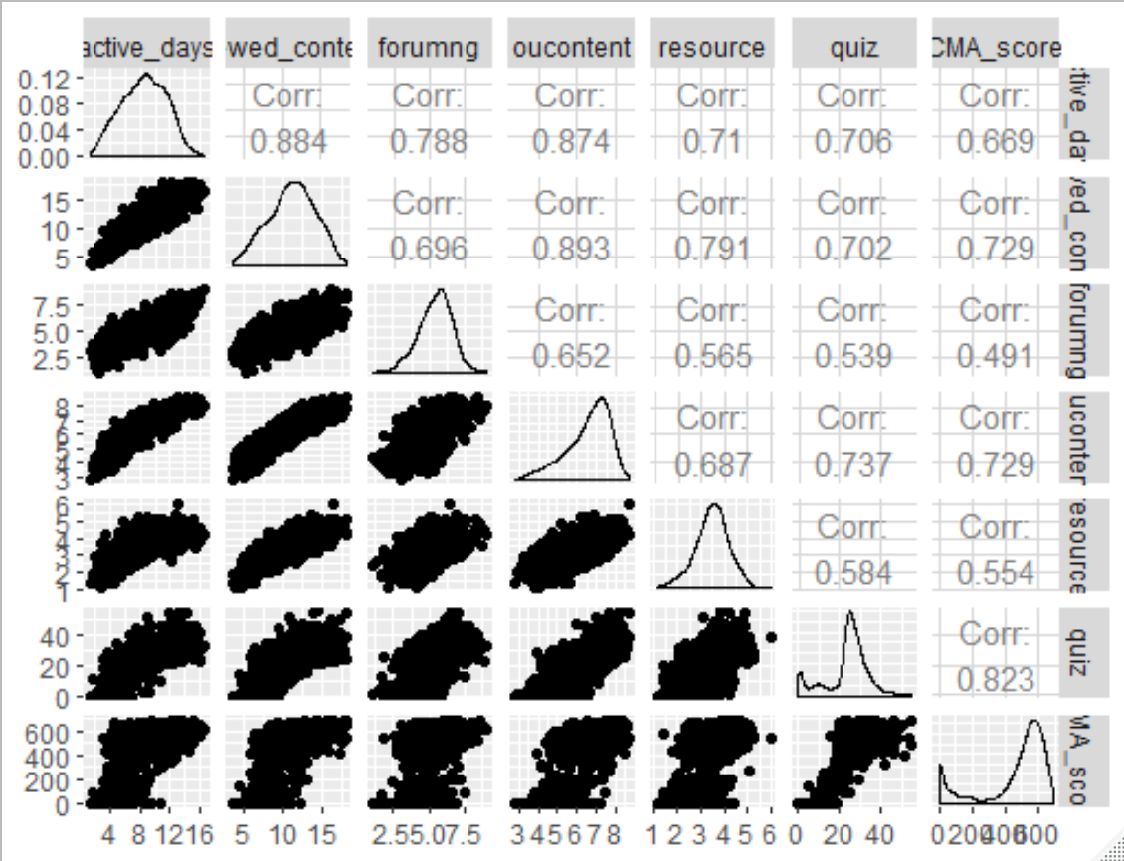
Data after Preprocessing

Slide 15
Methodology
01
02
03
Factor Analysis
Orthogonal Factor Model & Maximum likelihood method
Discrimination and Classification
Fisher’s Linear Discriminant Analysis(LDA)
Model Evaluation
Cross validation

Slide 16
Exploratory Factor Analysis
Exploratory factor analysis (EFA) is a technique that is used to reduce a large number of variables into fewer numbers of factors.
X = µ + L F + ε
(p *1) (p *1) (p×m) (m×1） (p×1)
Where X is the observable random vector, µ is the mean, L is the matrix of factor loadings, F is common factors, ε is the error term. This technique extract maximum common variance from all variables and puts them into a common score. As an index of all variables, we can use this score for further analysis.
Assumptions:
Variables should be continuous.
There is linear relationship, there is no multicollinearity.
There is true correlation between variables and factors.
In general, linear FA does not require normality of the input data. Moderately skewed distributions are acceptable. Several methods are available, in this project , we use orthogonal factor model (PCA) analysis and maximum likelihood method (ML).

Slide 17
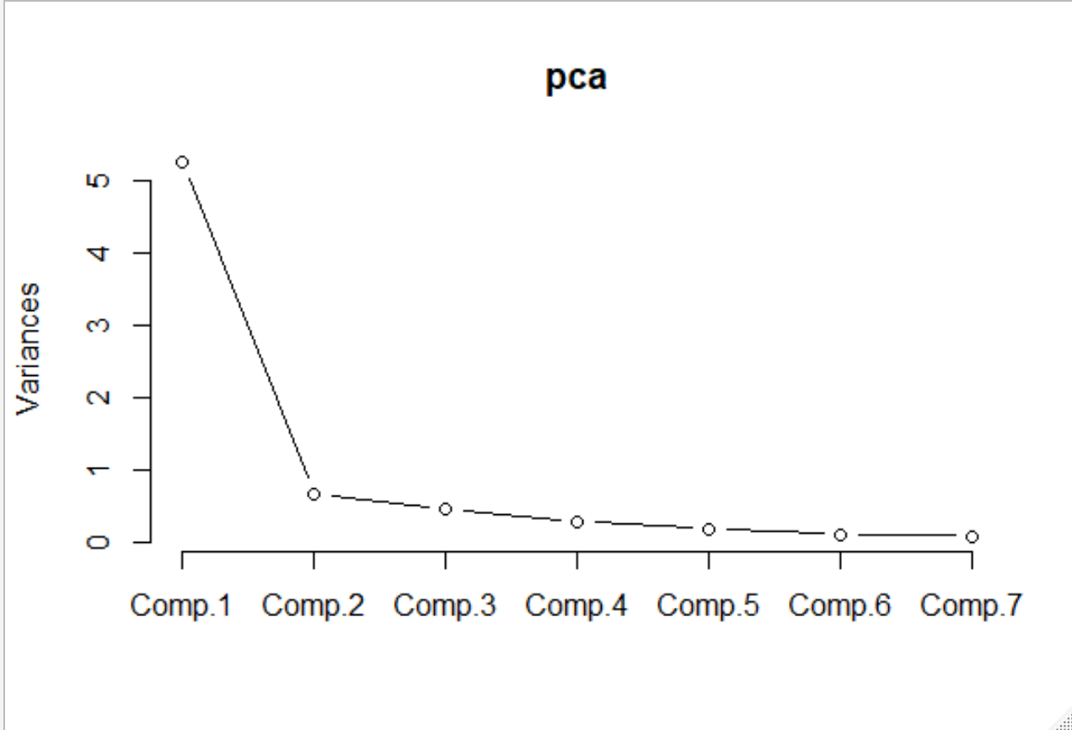
Exploratory Factor Analysis
Orthogonal factor model is based on the method of the principal component (PCA). It starts extracting the maximum variance and puts them into the first factor. After that, it removes that variance explained by the first factors and then starts extracting maximum variance for the second factor. This process goes to the last factor
Maximum likelihood, also called the maximum likelihood method, is the procedure of finding the value of one or more parameters for a given statistic which makes the known likelihood distribution a maximum. If the data appear to be normally distributed, then the additional efficiency of maximum likelihood estimation is highly worthwhile.

Slide 18
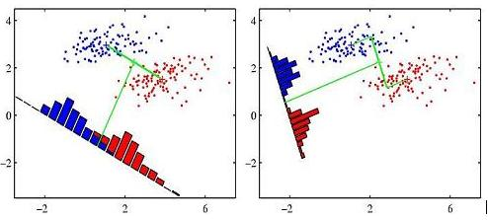
Fisher’s Linear Discriminant Analysis(LDA)
Discrimination and classification are multivariate techniques concerned with separating distinct sets of objects (or observations) and with allocating new objects to previously defined groups.
Fisher's idea was to transform the multivariate observations x to univariate observations y such that the y's derived from population π1 and π2 were separated as much as possible.
The discriminant scores are calculated for each observation for each class based on these linear combinations. The class with the largest score will be the classification prediction for that observation.

Slide 19
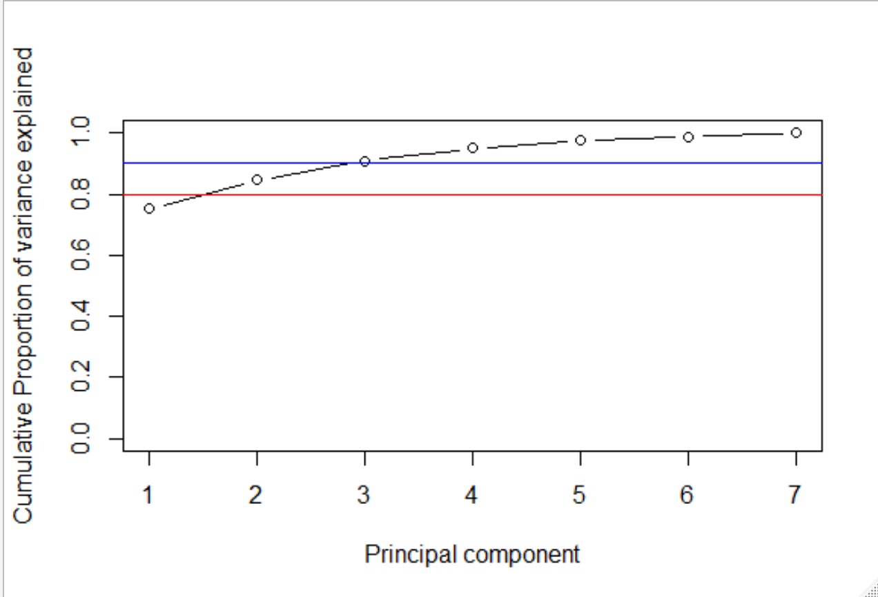
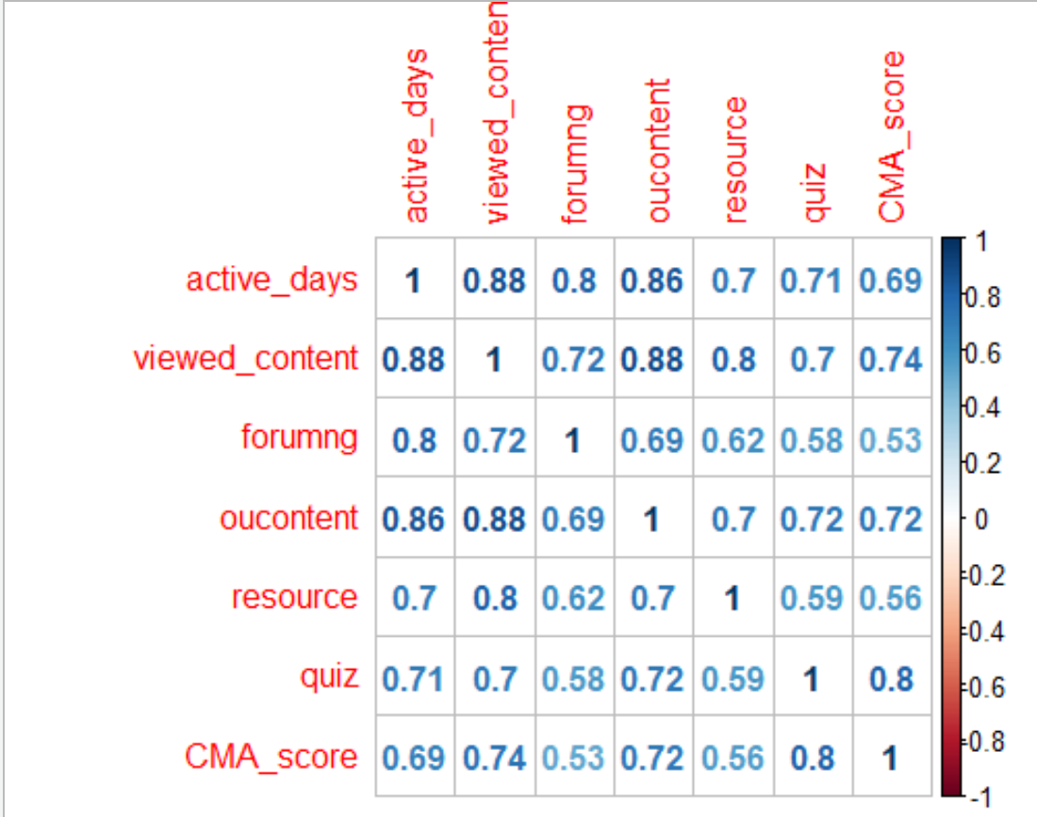
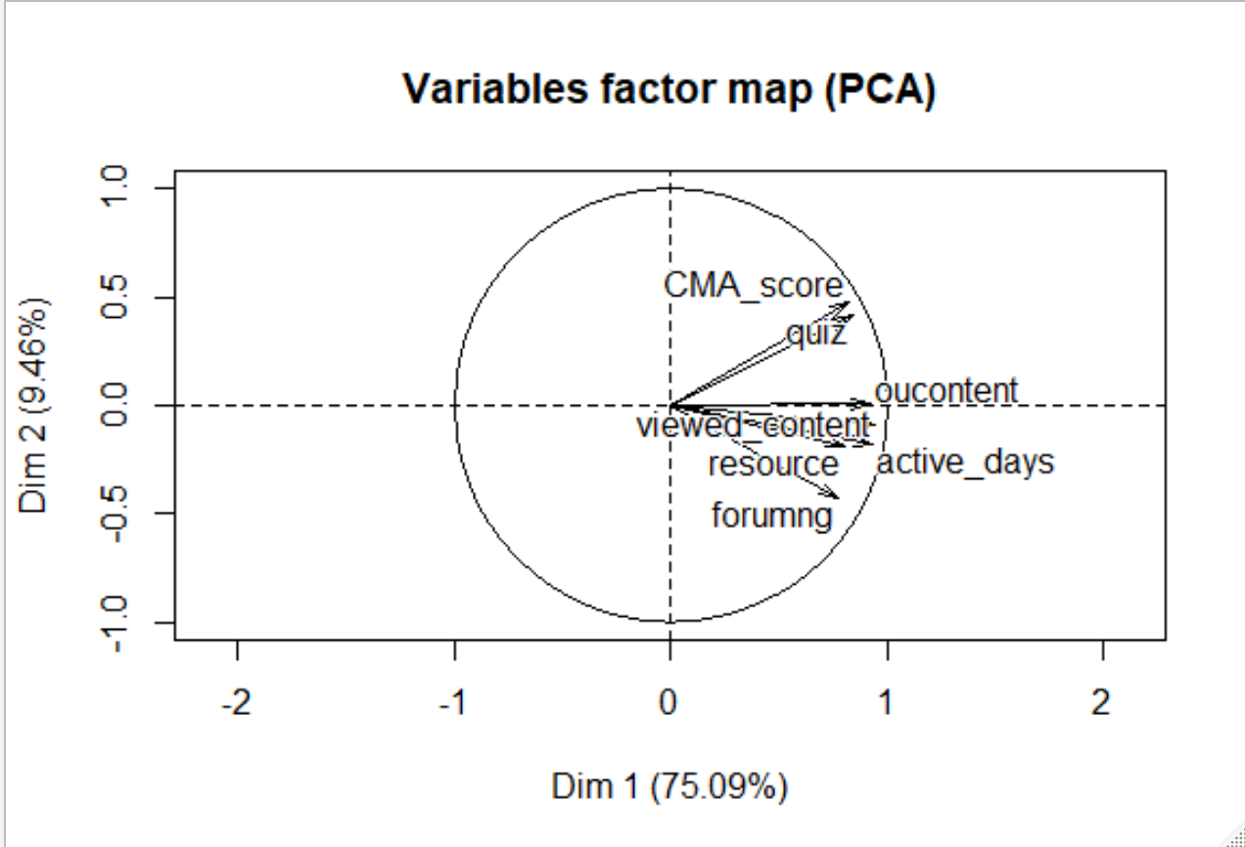
Results : Factor Analysis

Slide 20
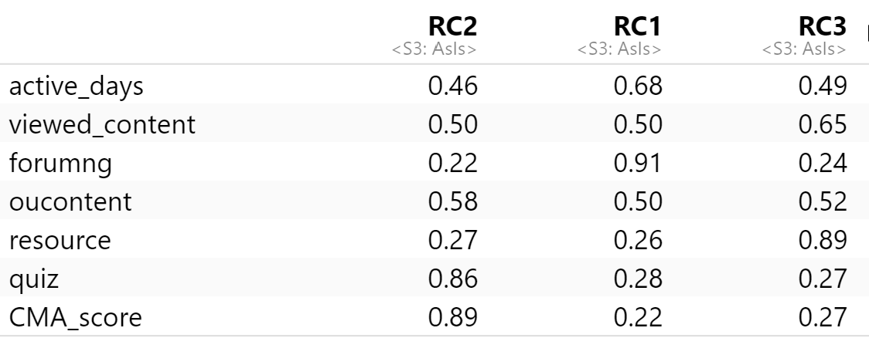
Factor Analysis(Orthogonal model )
RC2 Practice Factor
RC1 Interaction Factor
RC3 Content Factor

Slide 21
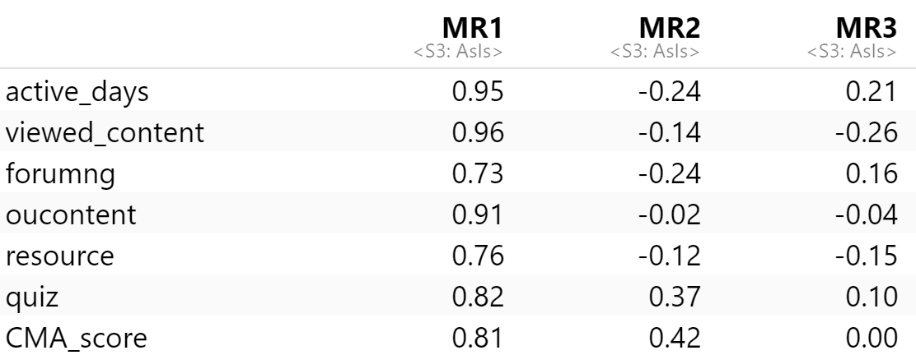
Factor Analysis (Maximum likelihood)
MR1 Activeness Factor
MR2 Practice Factor
MR3 Content Factor

Slide 22
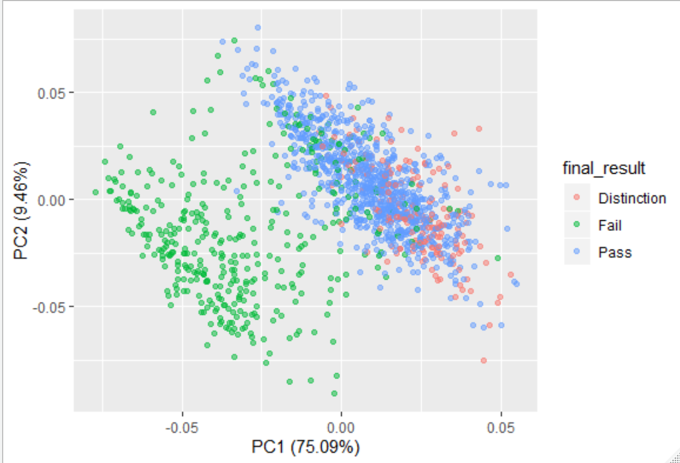
Result : Classification & Discrimination
There’s a clear difference between the fail students and the other two groups.
Distinction and pass students have higher score on PC1 and PC2
The points of pass students and distinction students are quite overlapped in the projection.
Points of fail students are more widely spread, while points of fail and pass students are quite concentrated.

Slide 23
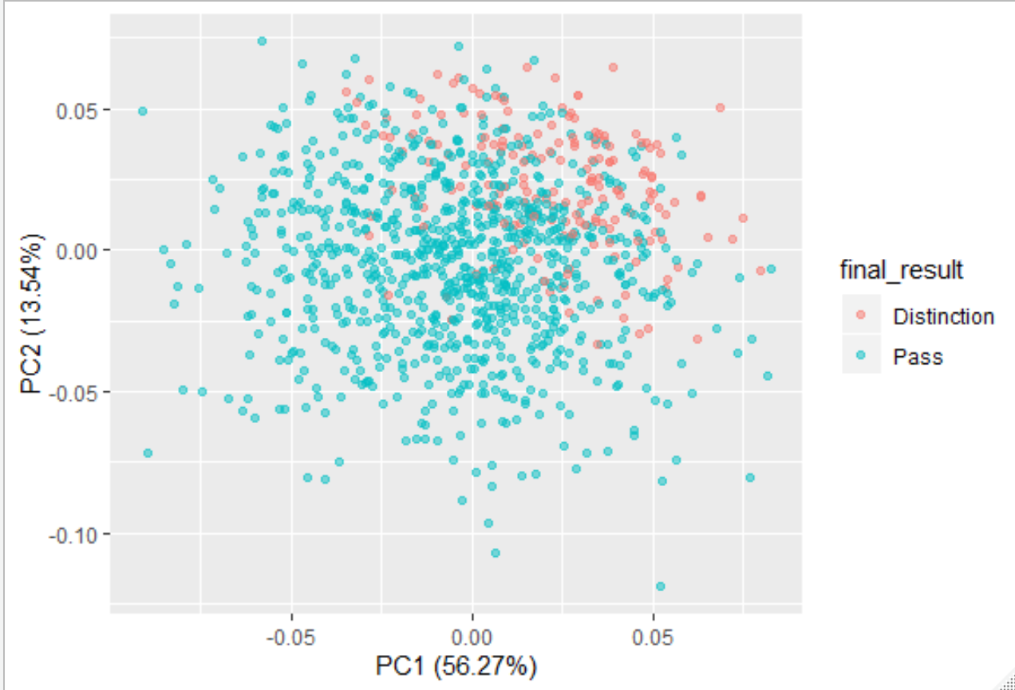
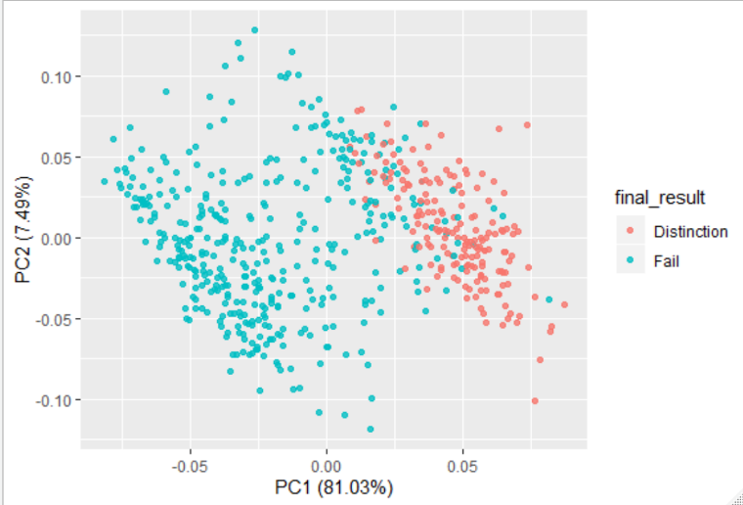
Result : Classification & Discrimination
Distinction students have higher value and smaller variance in PC1 than fail students. This also happens between pass students and fail students.
The points of distinction students are highly overlapped with pass students, but the overall value in PC2 is much higher than pass students.
The difference is not easy to detect in figure1, but when shifting to another project dimension, the pattern became obvious.

Slide 24
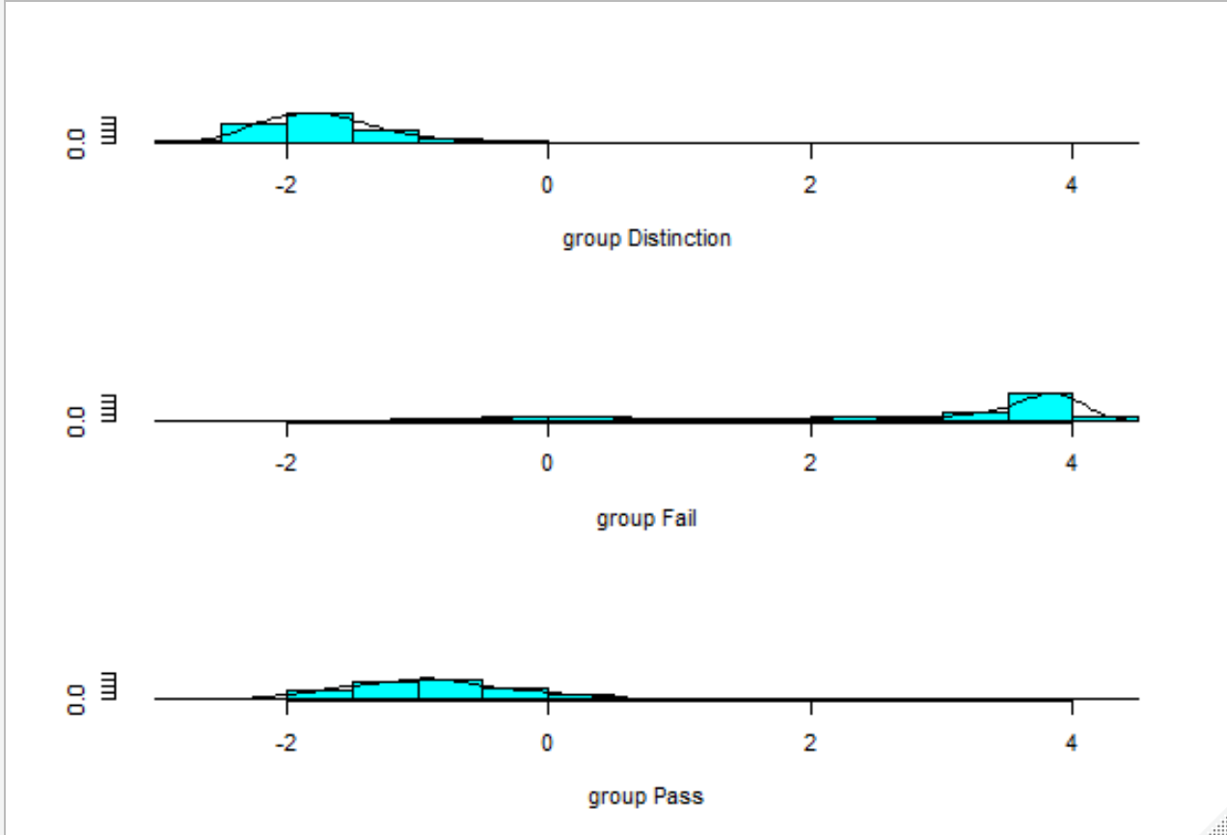
Fisher’s LDA for Discrimination
 | distinction | fail | pass
distinction | 58 | 0 | 44
fail | 0 | 304 | 4
pass | 123 | 93 | 826
Compare the result from the LDA model and the true result. the overall accuracy of the prediction is 0.82, the accuracy of predicting fail is 0.98, the accuracy for predicting distinction is 0.57, the accuracy of pass is 0.79.

Slide 25
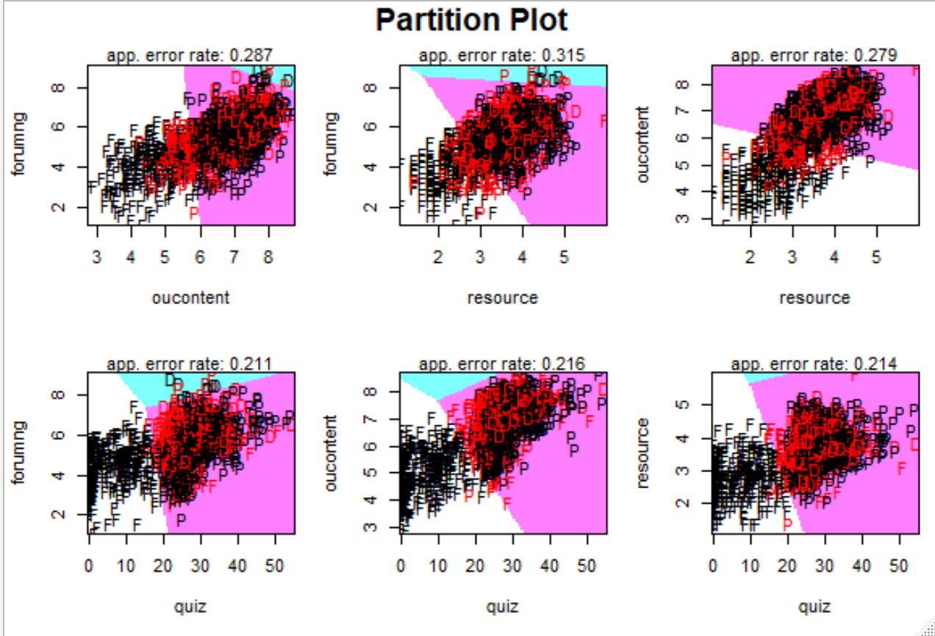
Combination of Two Variables
The partition plot shows how students were discriminated by the combination of two factors.
In most cases, the error rate is below 0.3, the lowest error rate occurs with the combination of quiz and forumng.
As the plot shows, pass and distinction students make more clicks on quiz than fail students. Distinction students makes more clicks than pass students.

Slide 26
Cross Validation
 | distinction | fail | pass
distinction | 33 | 0 | 27
fail | 0 | 101 | 31
pass | 37 | 4 | 250
55%
89%
76%
The overall accuracy of the prediction is 0.80, the accuracy of predicting fail is 0.76, the accuracy for predicting distinction is 0.55, the accuracy of pass is 0.86.

Slide 27
Discussion: Different types of Interaction in MOOCS
There are three most common types of interaction discussed in the distance education literature, which are the learner-instructor, learner-learner, and learner-content interaction.
What types of interaction do these variables stand for in this project?
How these interactions influence the learning performance of students.

Slide 28
Suggestions for Learners
Being active is very important, most students with higher activity finished the course with good results.
Doing practice is critical for getting pass, all the homework and quiz should be taken as seriously as in physical classes.
Making meaningful interactions is necessary for students who want to improve their performance to a higher level.

Slide 29
Suggestions for
Course Designers
Designers may apply some mechanisms like locking the next chapter until the learner finish the existing quiz.
Designers should create and select content very carefully, avoid pointless materials which may blur the objectives of the courses.
Grad materials with importance levels, tell learners which contents should have higher priority if they have limited time.

Slide 30
Suggestions for MOOC Platforms
The platform should establish a system for tracking the status of students, the system can create weekly or monthly learning reports for each user, show the progress they made and gaps they need to pass over.
If the student shows low engagement, the system should send notifications to cheer them up.
If the student shows the tendency of failing the course, the system should send alert and provide suggestions for catching up.

Slide 31
THANKS
Thank you for your excellent teaching, I really appreciate all your works! Be well and stay healthy !

